Slide 1

CSE 583
Software Design for Data Scientists Course Introduction, Command Line & Data Essentials
David Beck^{1,2,3}, Joseph Hellerstein^{1,3}, Bernease Herman¹
Colin Lockard³
¹eScience Institute
²Chemical Engineering
³Computer Science
University of Washington
September 27, 2018

Slide 2
What's the class about? Who are we?
Objectives
Teach how to create and collaborate on data- and computation-intensive research projects
Provide practical software skills for data analysis in research & industry.
Elevate coding in science to the level of technical writing.
Instructor introductions

Slide 3
Agenda
Why data science?
Course overview
Pronto data
Getting data with shell scripts
3

Slide 4
Why
Data Science?
4

Slide 5
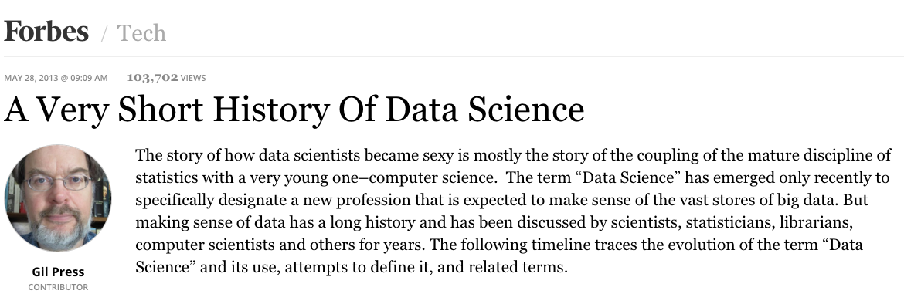
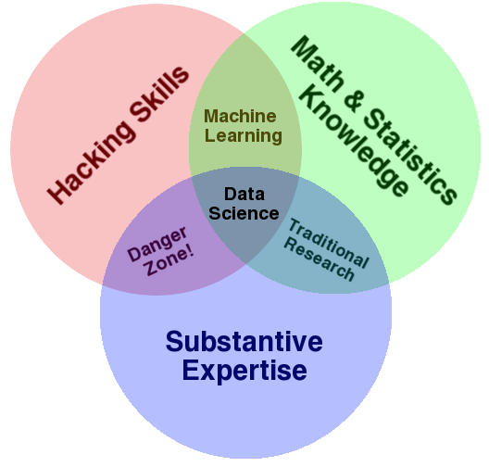
Data Science
https://escience.washington.edu/data-science-courses-at-the-university-of-washington/

Slide 6
Course Registration by Field of Study

Slide 7
Course Overview
7

Slide 8
Survey Results
Question | Response
Years of programming? | Mostly > 1 yr
Years of python? | < 1 yr
Experience with a text editor | Mostly "Yes"
Comfort with if-statements? | Yes
Comfort with for-statements? | Yes
Comfort with functions? | Mostly "Yes"
Python packages (scipy, pandas, ...) | Mostly "No"
Experience with iPython? | Very little
Experience with github? | Very little

Slide 9
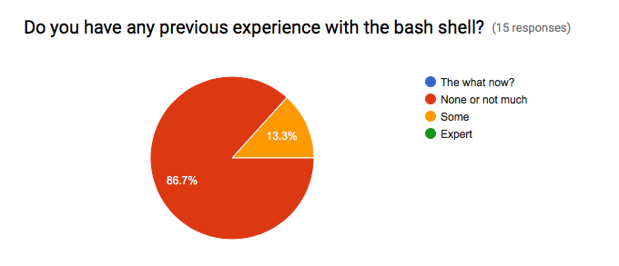
Survey Results

Slide 10
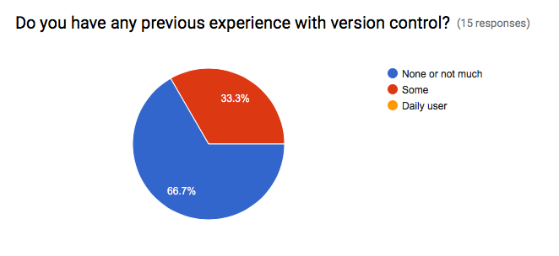
Survey Results

Slide 11
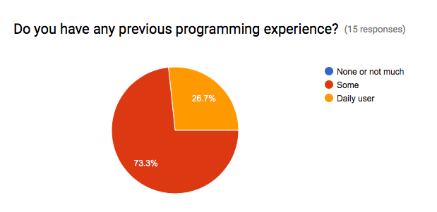
Survey Results

Slide 12
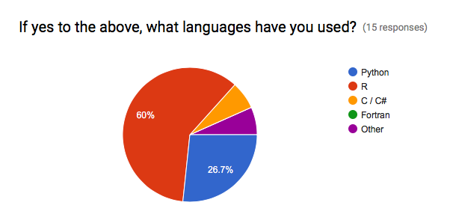
Survey Results

Slide 13
Skills Taught
Program in python using the Python scientific stack, including numpy, pandas, and matplotlib.
Search, evaluate, and integrate into a project externally developed Python packages; create your own Python packages.
Develop unit tests that validate important aspects of the project implementation.
Develop software that it can be used by others including: shared code on github, documentation, installing packages, setup, and running computational studies.
Create technical specifications for what a program should do and how this is accomplished.

Slide 14
Course Structure
http://uwseds.github.io/syllabus.html
Programming basics (3 weeks)
Version control, Python, data manipulation
Software development (3 weeks)
Debugging, documentation, design, collaboration
Data manipulations in detail (2 weeks)
Visualization, machine learning
Software engineering practicum (2 weeks)

Slide 15
Programming vs. Software Engineering
Analogy: What is the difference between the following kinds of writing:
Note to yourself
An article in the NY Times
15

Slide 16
Relating Writing to Software
How Learn Skills
Reporter
Writing quality
Content
Structure
Review
SW Eng
Code quality
Features
Design
Testing
Freshman English
Programming
class
{
{
Composition & literature classes, professional writer
Computer Science degree, Collaborate on a big project
16

Slide 17
Grading
Item | %
Homework (~7 homeworks) | 35
Class participation | 15
Class project | 50
17
Notes:
Describe the importance of the homework and address concerns about rigidity for grad students

Slide 18
Grading
How we grade homework…
You submit homework using GitHub (version control tool) by the due date
We take up to a week to review the homework and give feedback with a GitHub Issue
You have an additional week to revise the homework to address any weaknesses
Your final grade for a homework given
There is no reason you can’t get 5/5 on all HW
18
Notes:
Describe the importance of the homework and address concerns about rigidity for grad students

Slide 19
Course Web Page
http://uwseds.github.io
19

